Slide 1

Enhancing Northeastern’s Workday Portal with Email Notifications

Slide 2
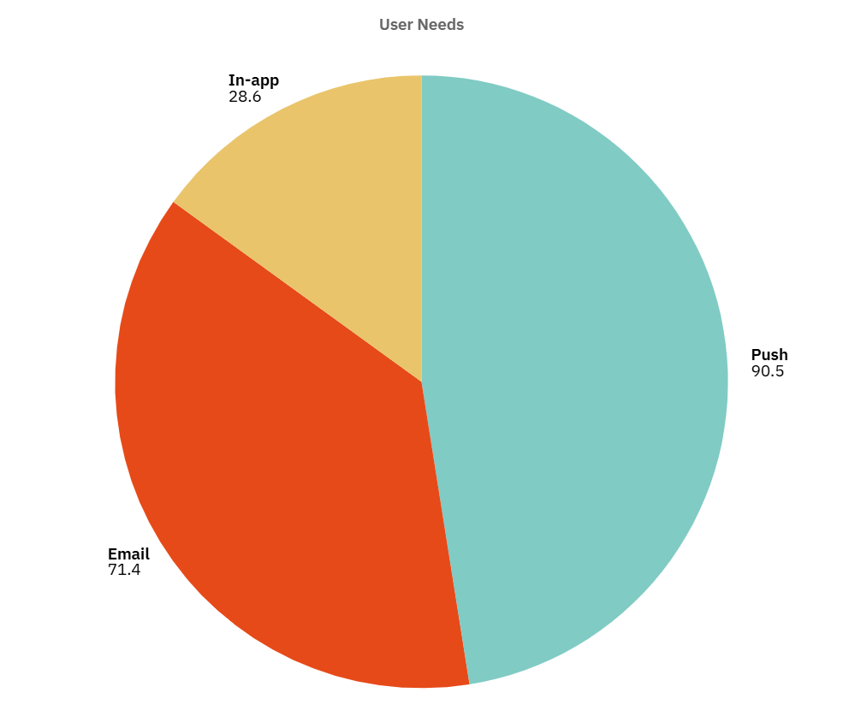

Why Email Notifications Matter?
Northeastern’s My Workday portal is critical for international students seeking on-campus jobs. (A May 2025 survey of 63 students ))
73% of 63 surveyed students miss job opportunities due to no notifications.
Solution: Enable Workday’s Job Alerts for daily email notifications.
Impact: Save 10–20 min weekly, boost applications by 30%, enhance satisfaction (3.1/5 to 4/5).

Slide 3
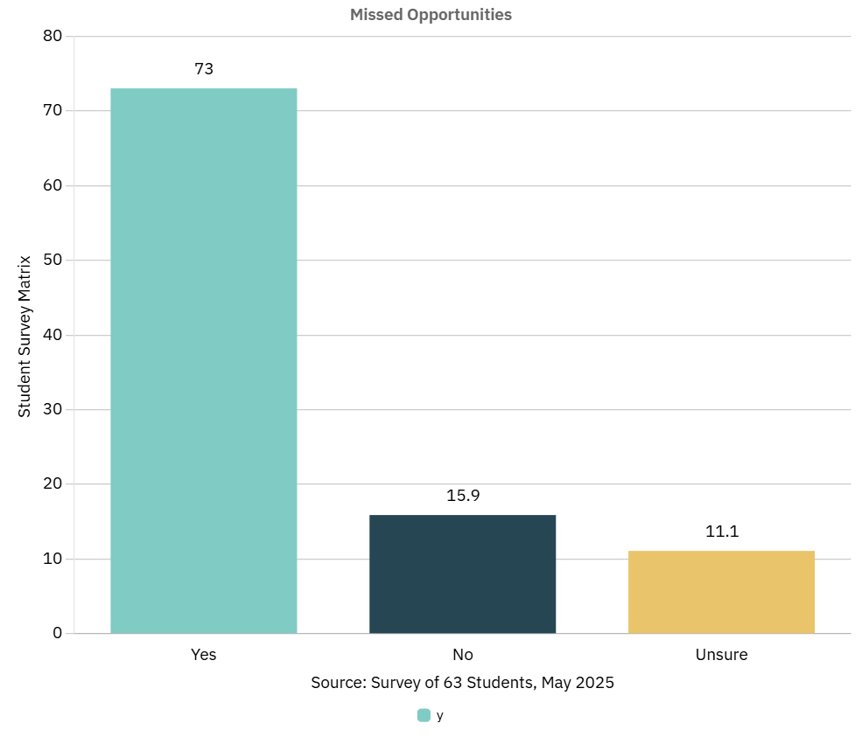
The Challenge with My Workday
Northeastern University’s Workday job portal lacks notifications, causing students to miss on-campus job opportunities. This proposal offers a simple email notification feature to alert students of new postings. A prototype (https://husky-hub-alert-emails.lovable.app/) demonstrates the solution, enhancing job access for students.

Slide 4
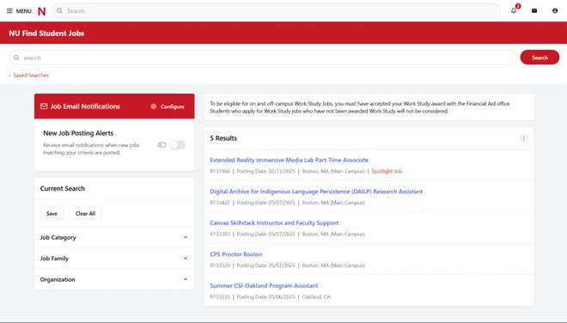
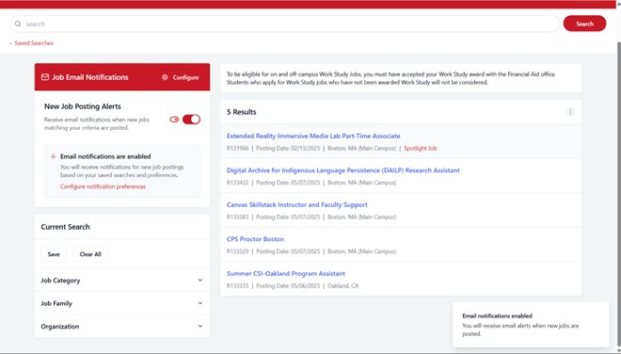
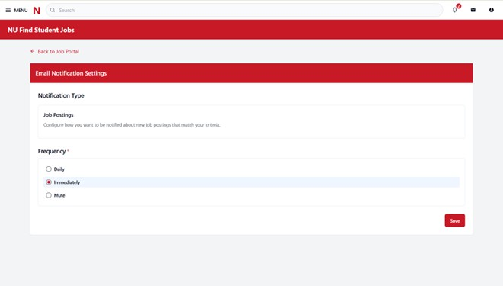
Workday Job Alerts Implementation
Phase 1 (4 Months):
Add “Subscribe to Job Emails” toggle in “Find Jobs” dashboard.
Pop-up prompt on login for one-click setup (<30 sec).
Daily email alerts via Northeastern’s Outlook system.
Phase 2 (6–12 Months):
Filters for campus location and federal work-study eligibility (38.1% demand).
User Education: Video tutorial, FAQ, email/social media promotion.

Slide 5
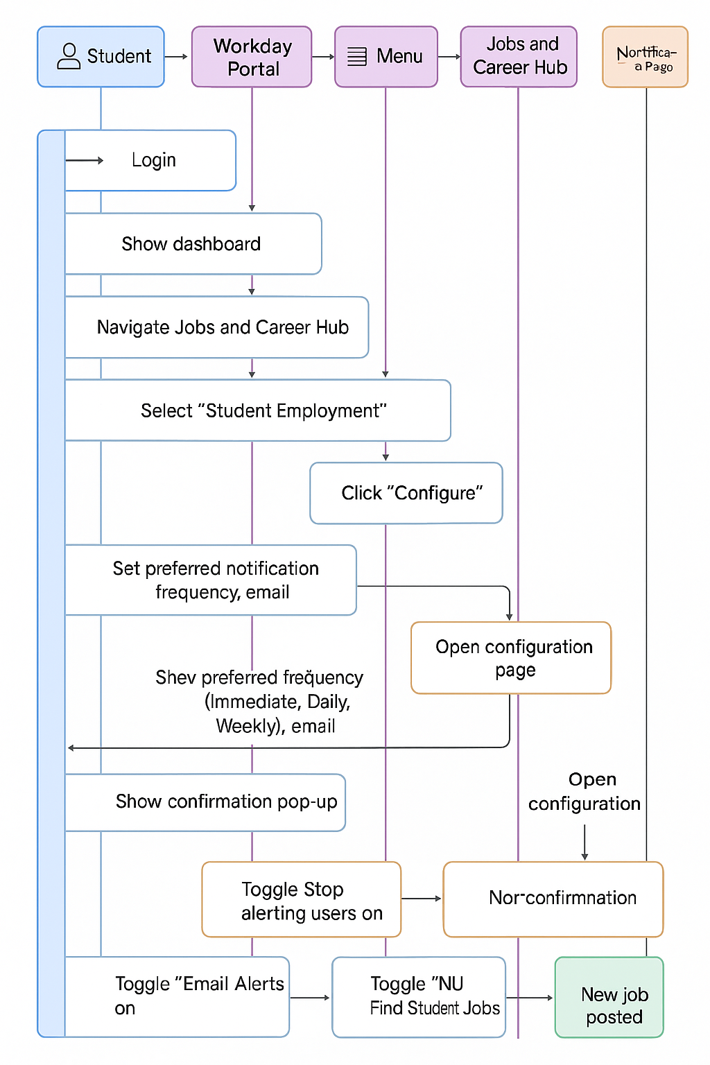
A Seamless Student Experience
Scenario: International student logs into Workday.
Pop-up: “Enable daily email alerts” (one-click toggle).
Next day: Email alert for IT support job in Boston.
Outcome: Applies in <24 hours, saves 10–20 min weekly.

Slide 6
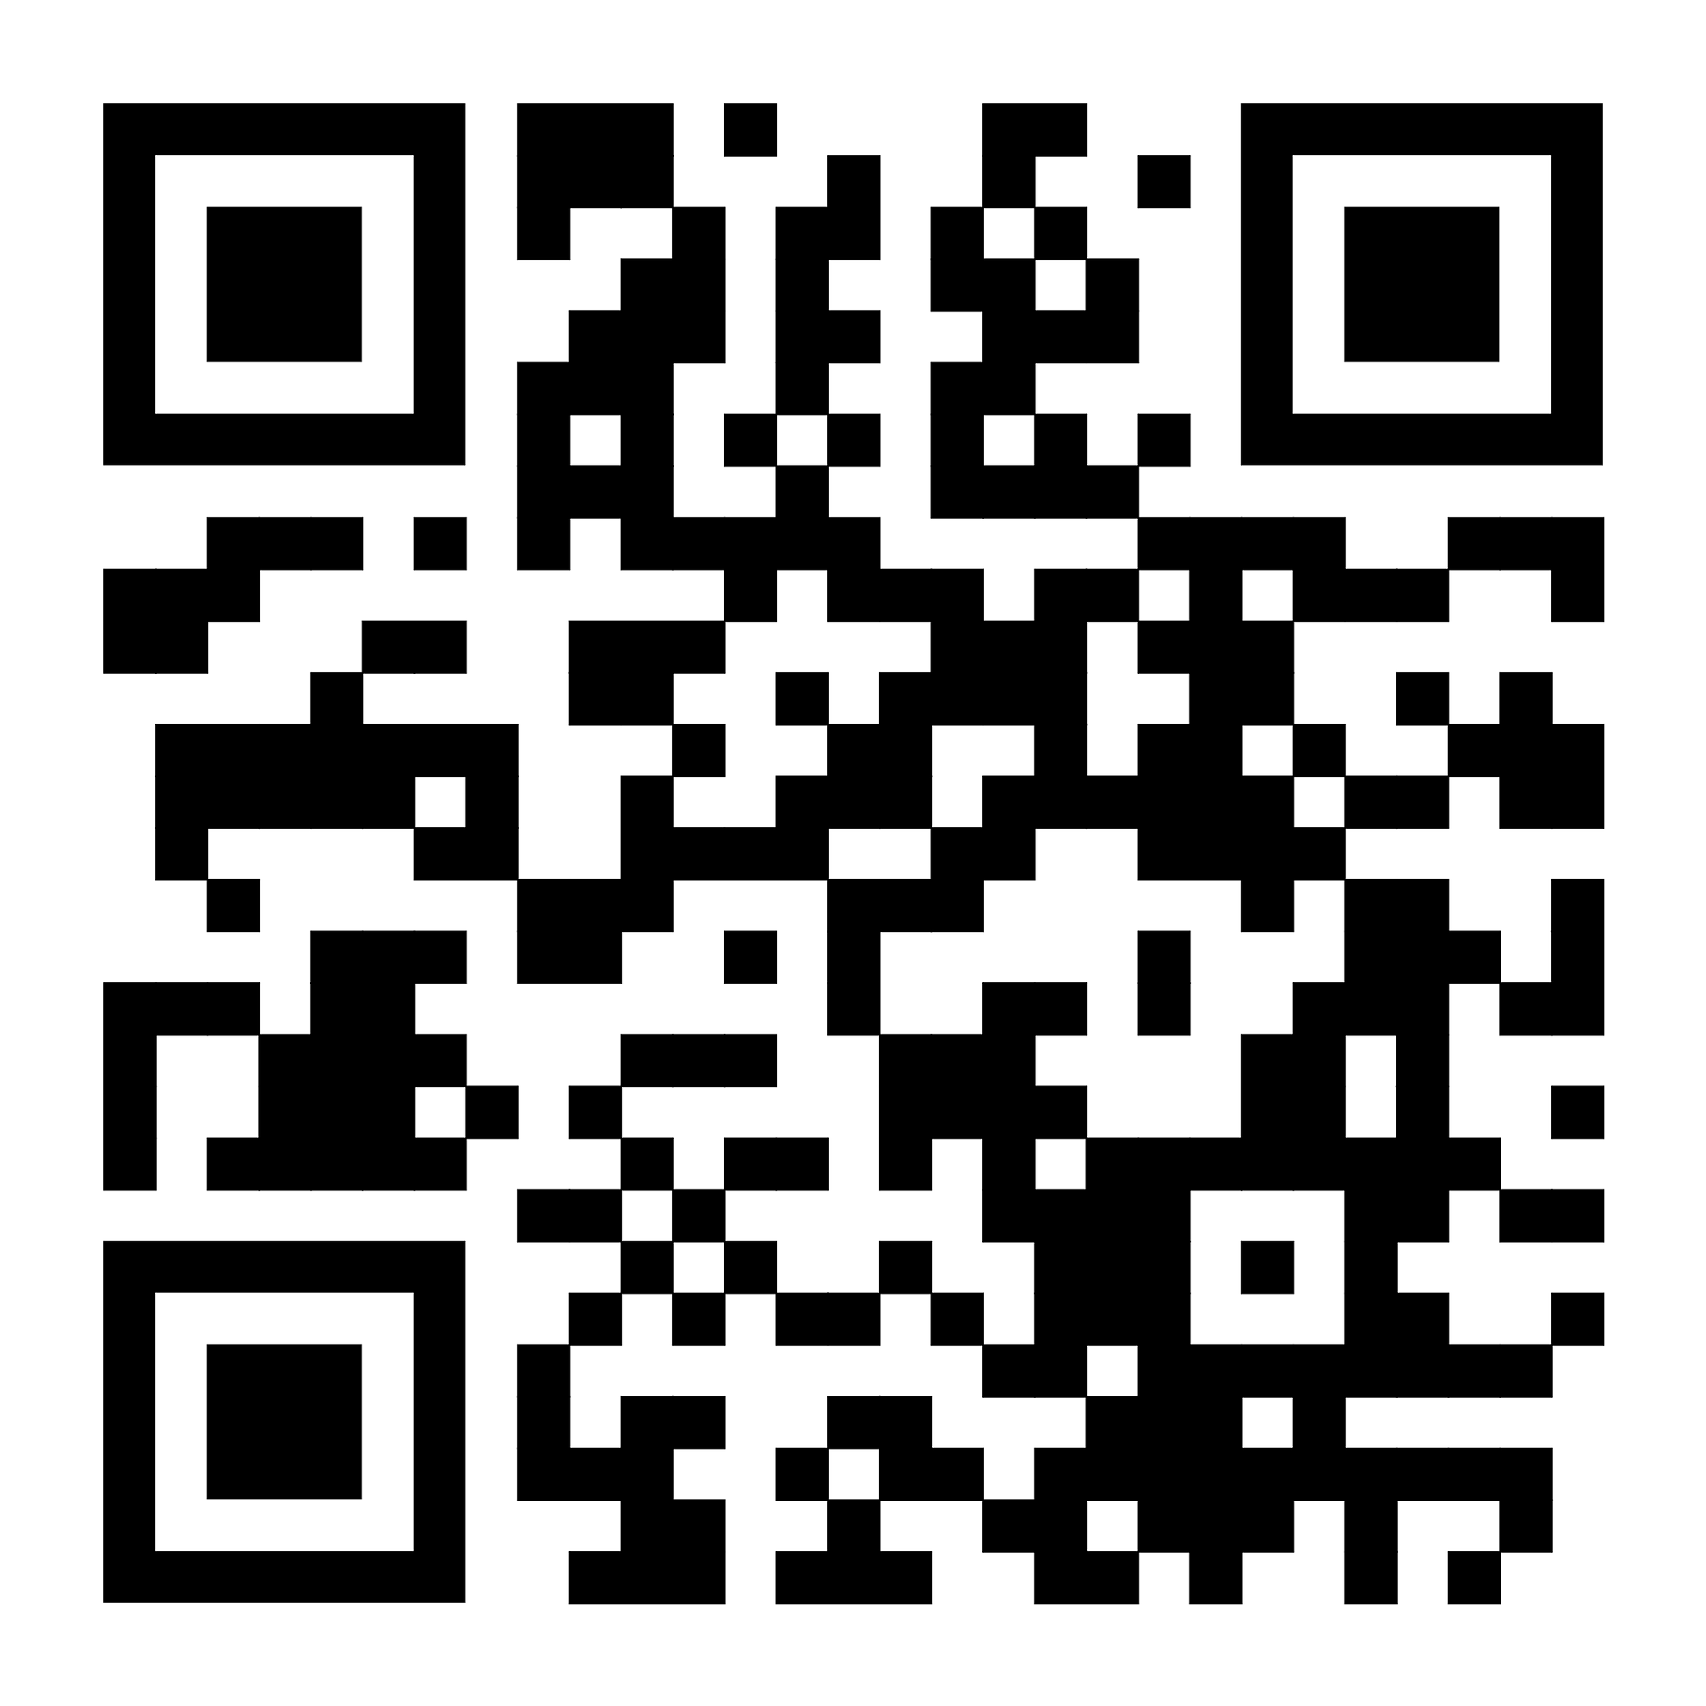
See It in Action See It in Action
Interactive prototype showcases:
“Subscribe to Job Emails” toggle.
Pop-up prompt for quick setup.
Clean, user-friendly design.
Link: https://husky-hub-alert-emails.lovable.app/

Slide 7
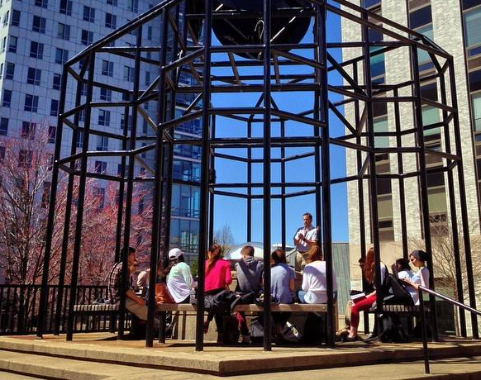
Benefits
Students: Save 10–20 min/week, 30% more applications, tailored alerts.
Recruiters: Faster role filling, reduced vacancies.
Northeastern: Satisfaction up to 4/5, supports 88.9% international students.
Scalability: Serves 20,000+ students across 14 campuses.

Slide 8
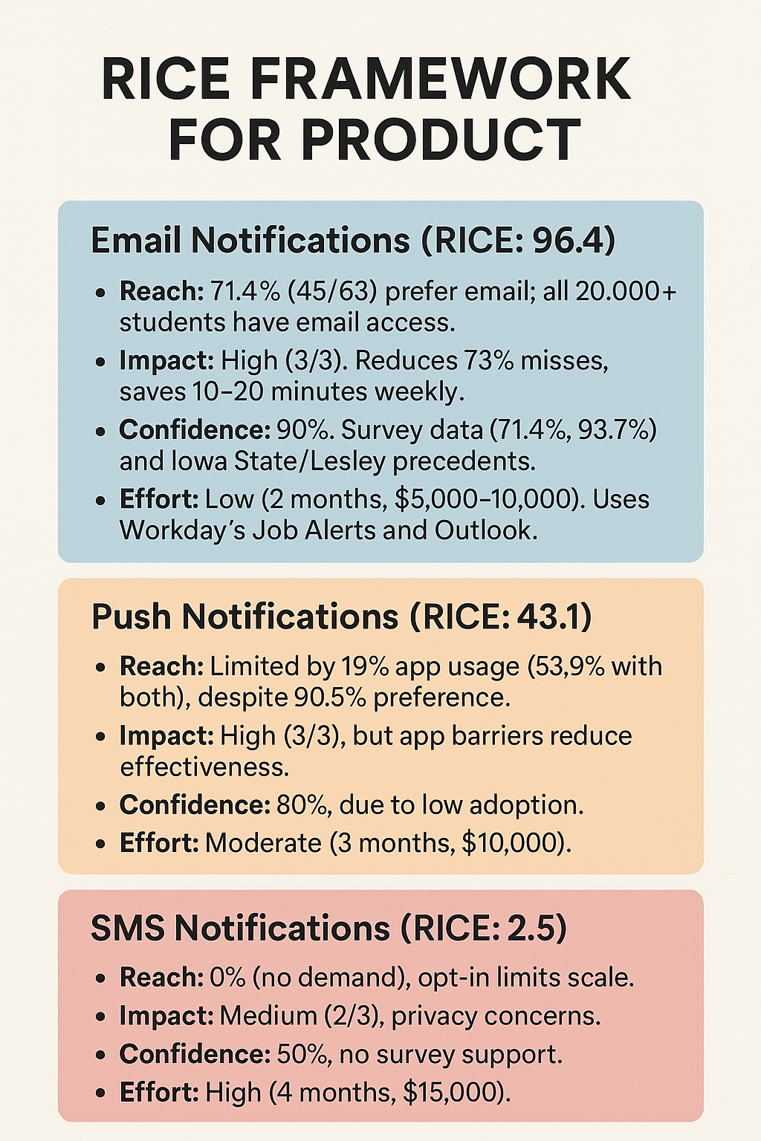
Why Email?
RICE Score (Email Notifications): 96.4
Reach: 71.4% prefer email, 20,000+ students accessible.
Impact: Reduces 73% misses, saves time.
Confidence: 90% (survey + Iowa State/Lesley precedents).
Effort: 2 months, $5,000–10,000 (Workday + Outlook).
Precedents: Iowa State, Lesley, Washington and Lee use Workday Job Alerts.
Cost: $500/month maintenance.

Slide 9
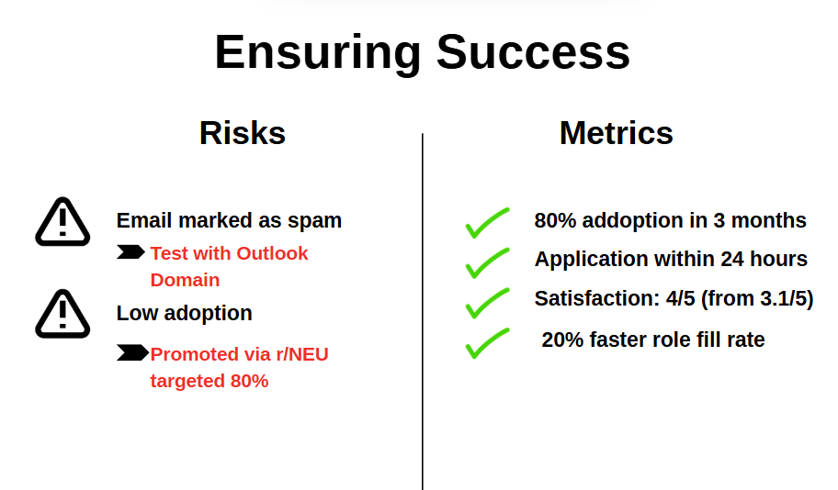
Ensuring Success
Risks:
Emails marked as spam (Mitigation: Test with Outlook domain).
Low adoption (Mitigation: Promote via r/NEU, target 80%).
Metrics:
80% adoption in 3 months.
Applications within 24 hours.
Satisfaction: 4/5 (from 3.1/5).
20% faster role fill rate.

Slide 10

Let’s Transform Workday
Approve Phase 1 for email notifications (4 months, $5,000–10,000).
Support 38% international students and 20,000+ users.
Next Steps: Meet with IT Services and Student Employment to align.

Slide 11

Supporting Evidence
Iastate.edu. (2019). Job alerts now available in Workday. [https://www.inside.iastate.edu/index.php/article/2019/09/26/jobalerts]
Support Hub. (2024). Creating a Job Alert in Workday. [https://support.lesley.edu/support/solutions/articles/4000196470-creating-a-job-alert-in-workday]
Wlu.edu. (2025). Workday Application Instructions. [https://www.wlu.edu/employment-opportunities/staff-positions/application-instructions-for-new-external-applicants]
UNLV Workday Email Notifications. [https://www.unlv.edu/sites/default/files/page_files/27/Workday-Email-Notifications.pdf]

Slide 12
Thank You!

